Slide 1
Summarizing Basic Cryptographic Concepts
Lesson 5
M6S1 Introduction to Cybersecurity Defense
Notes:
This lesson starts the next block of the course, which is focused on the protect function. The first part of this will cover IAM topics, and cryptography underpins most of these technologies.
Topics:
Compare and contrast cryptographic ciphers.
Summarize cryptographic modes of operation.
Summarize cryptographic use cases and weaknesses.
Summarize other cryptographic technologies.

Slide 2
Compare and Contrast Cryptographic Ciphers
Topic 5A
M6S1 Introduction to Cybersecurity Defense
Notes:
This topic covers the basic cryptographic primitive types: hashing, symmetric ciphers, and asymmetric ciphers.
Objective 2.8 is covered over the course of all the topics in this lesson.
It is easy for students to become confused about the different types of cryptographic systems, so allocate plenty of time to covering this topic.

Slide 3
Syllabus Objectives Covered
2.1 Explain the importance of security concepts in an enterprise environment (Hashing only)
2.8 Summarize the basics of cryptographic concepts
M6S1 Introduction to Cybersecurity Defense

Slide 4
Cryptographic Concepts provides for secure communication in the presence of malicious third-parties
Provides us Confidentiality, Authentication and access control, Non repudiation, int
Encryption and decryption—encoding and decoding
Plaintext is the unencoded message – I am learning comptia sec+
Ciphertext is the coded message - Pm81NnmppTBhTPxxB30WHIb7y++WcrTSoIxHEJzsbuU=
Cipher is the means algorithm used
Cryptanalysis is the art of cracking cryptographic systems
Types
Symmetric
Asymmetric/public key cryptography
Hashing algorithms – is a mathematical algorithm that converts an input data array of a certain type and arbitrary length to an output bit string of a fixed length.
M6S1 Introduction to Cybersecurity Defense
Notes:
Note that in cryptography there is still some "obscurity" involved as you have to control distribution of the key. This is a simpler job than protecting the design of the algorithm, however.
Passive eavesdropping is traditionally performed by Eve, but we're just using Mallory for simplicity.

Slide 5
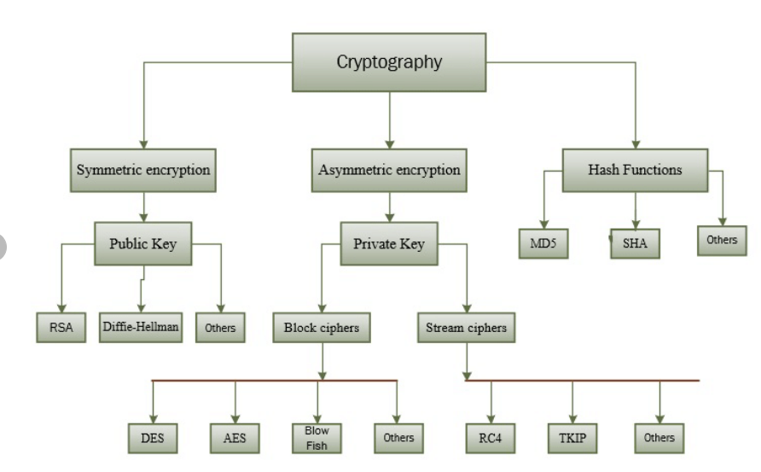
One key to encrypt a plain text
Asymmetric encryption is also known as public key cryptography
two keys to encrypt a plain text
M6S1 Introduction to Cybersecurity Defense

Slide 6
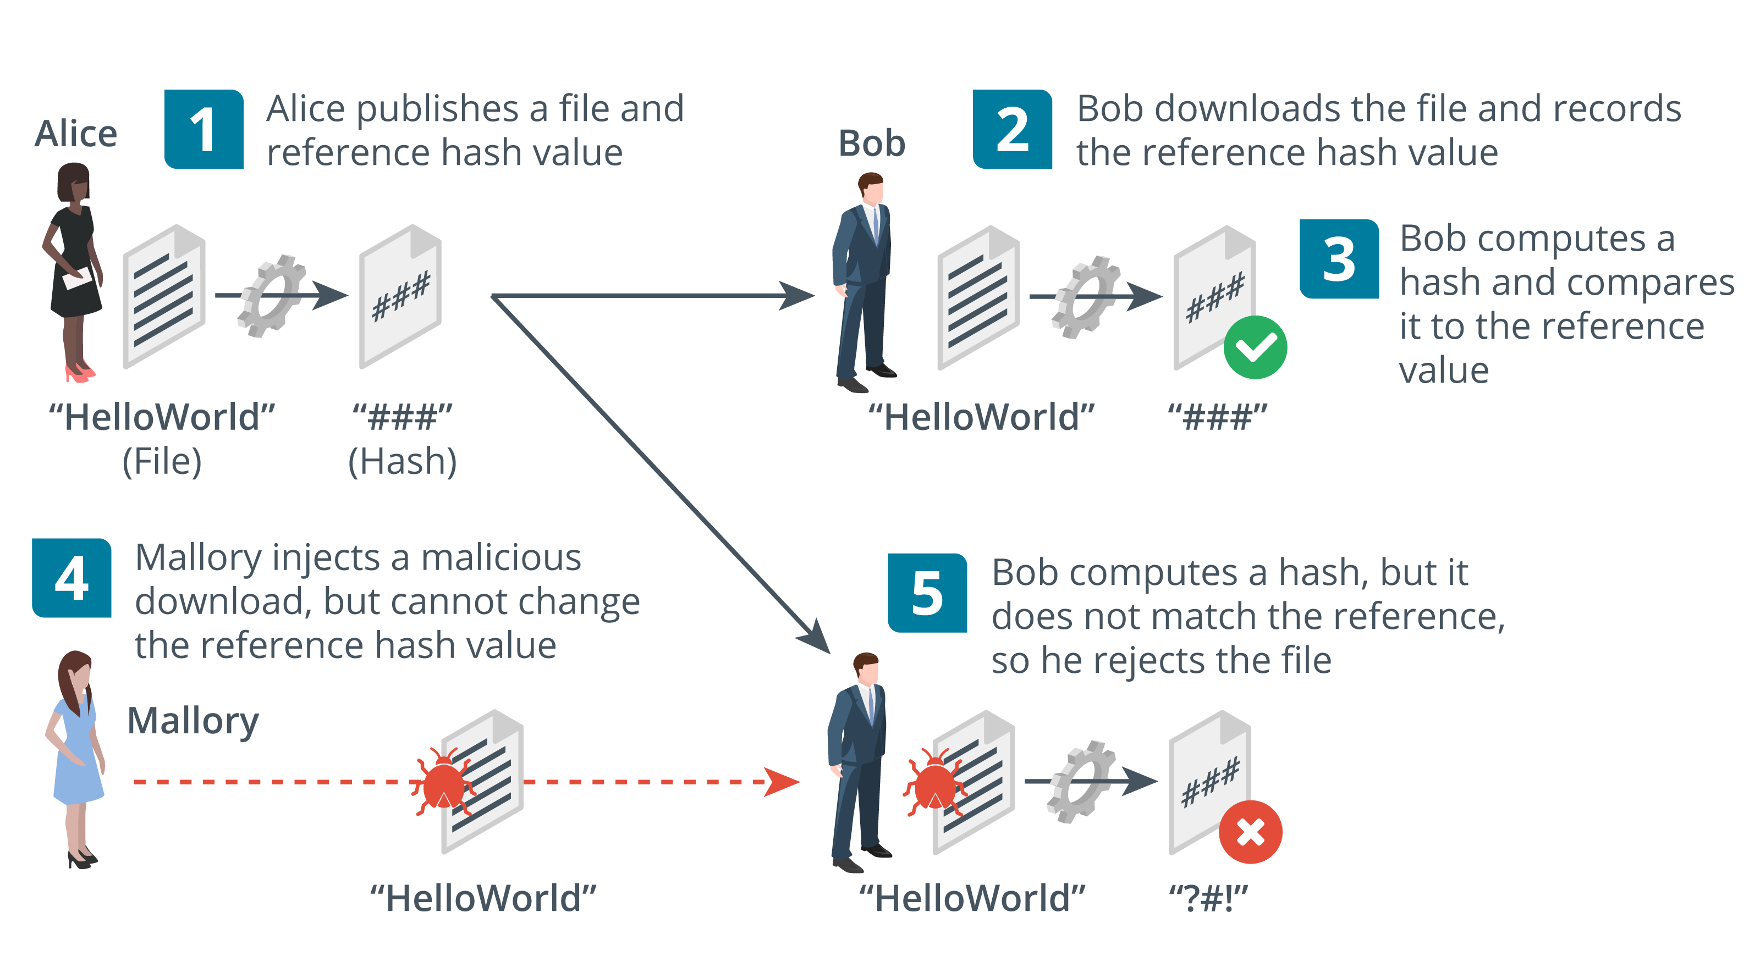
Hashing Algorithms - String fingerprint
Fixed length hash from variable string with cryptographic properties
One-way (plaintext cannot be recovered from the digest)
Anti-collision (no two plaintexts are likely to produce the same checksum)
Used for password storage and checksums (integrity)
Secure Hash Algorithm (SHA)
Message Digest Algorithm (MD5)
Images © 123rf.com.
M6S1 Introduction to Cybersecurity Defense
Notes:
Hash functions are mostly used for integrity (signatures and message digests) and password storage (confidentiality).
While the names of cryptographic algorithms have been removed from the certification objectives, they are still present in the acronyms list, and the injunction on the acronyms list is "Candidates are encouraged to review the complete list and attain a working knowledge of all listed acronyms as part of a comprehensive exam preparation program." Consequently, the names of the main products have been retained.
The syllabus also uses the term checksum for a message digest (under the forensics objective) so we are using that here too. You might want to note that hash functions produce a specific type of checksum, but there are others with different properties, such as a parity checksum.

Slide 7
Encryption Ciphers and Keys
Hashing is not encryption—the process is not reversible
Hashing is technique of mapping a large set of arbitrary data to tabular indexes using a hash function.
Encryption is a form of data security in which information is converted to ciphertext.
Encryption uses a reversible process based on a secret
Process should be too complex to unravel without the secret
M6S1 Introduction to Cybersecurity Defense
Notes:
Make sure students understand the difference between the cipher and the key.
You could also mention that most types of encryption make use of the XOR function.

Slide 8
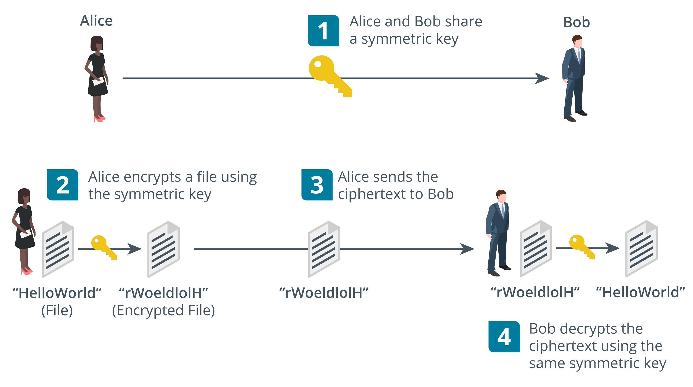

Symmetric Encryption uses a single key to encrypt and decrypt
Same secret key is used for encryption and decryption
Fast—suitable for bulk encryption of large amounts of data
Problem storing and distributing key securely
Confidentiality only— sender and recipient know the same key
Images © 123rf.com.
M6S1 Introduction to Cybersecurity Defense
Notes:
Note that symmetric encryption is mostly used for privacy (confidentiality). Test that the students can explain to you why it cannot be used for authentication, integrity, or non-repudiation.

Slide 9
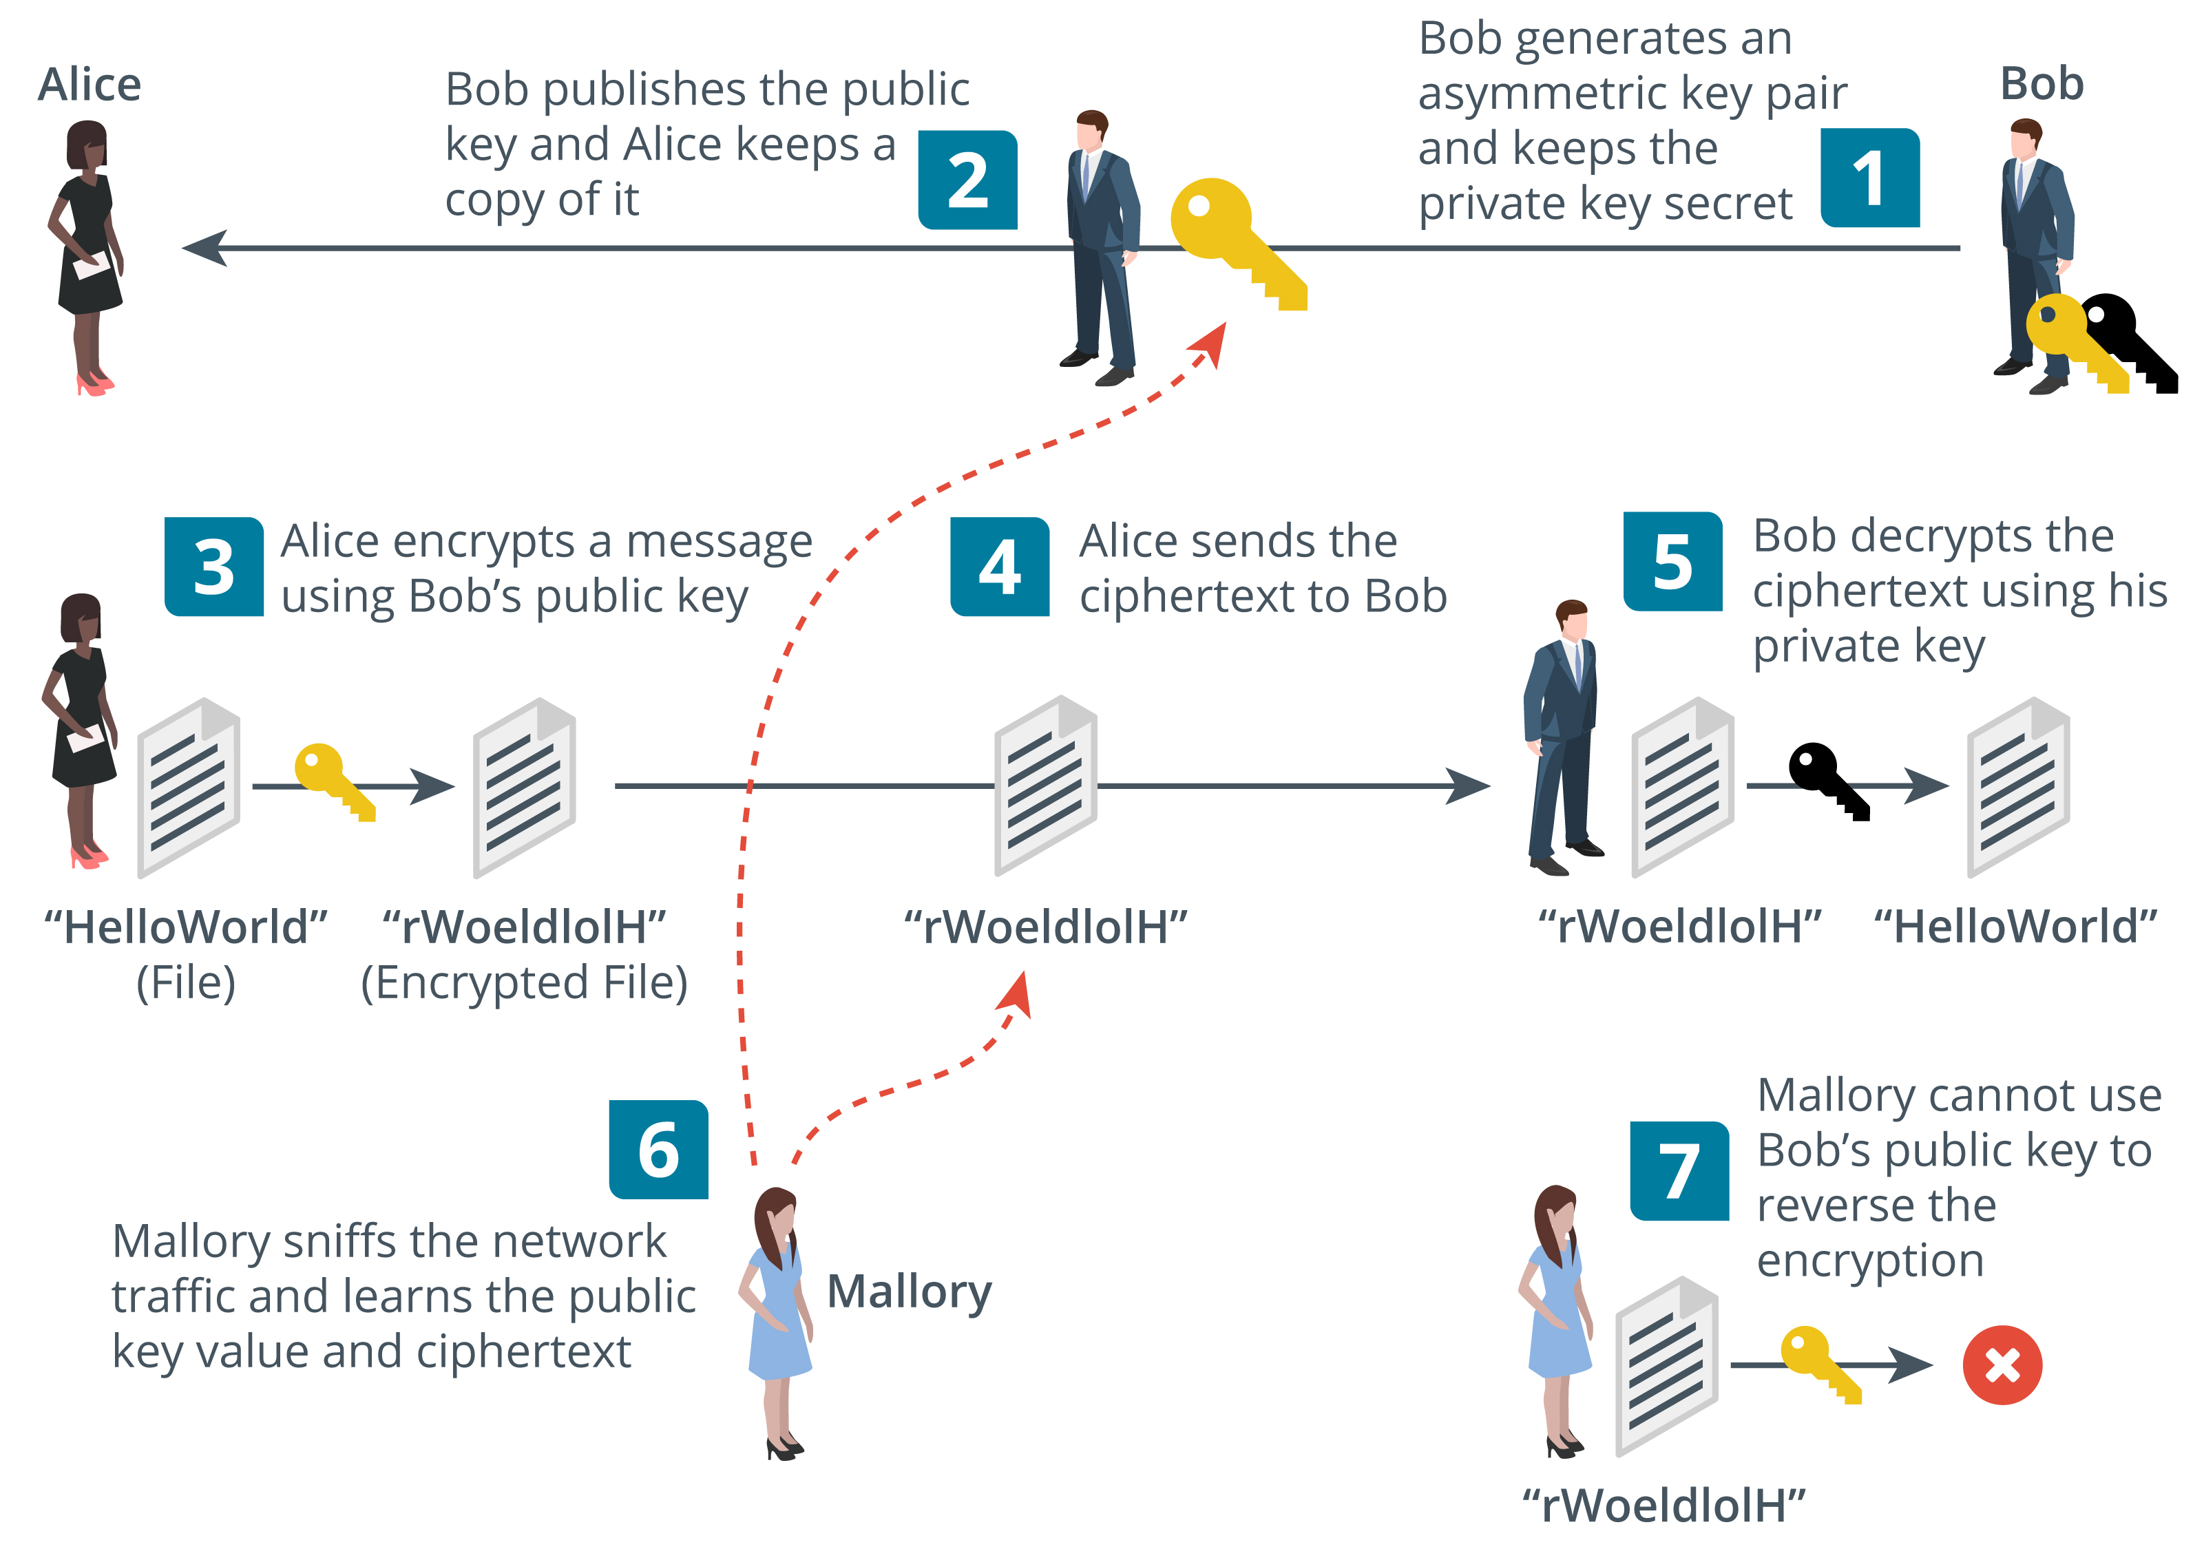
Asymmetric Encryption encrypts and decrypts the data using two separate yet mathematically connected cryptographic keys
Public/private key pair
If the public key encrypts, only the private key can decrypt
If the private key encrypts, only the public key can decrypt
Private key cannot be derived from the public key
Private key must be kept secret
Public key is easy to distribute (anyone can have it)
Message size is limited to key size so not suitable for large amounts of data
Used for small amounts of authentication data
Images © 123rf.com.
M6S1 Introduction to Cybersecurity Defense
Notes:
Asymmetric ciphers are mainly used for authentication and non-repudiation. Another important use is key exchange. A symmetric encryption key is encrypted by the client and sent to the server. The server decrypts the key and that secret key is then used to encrypt messages sent between server and client.

Slide 10
Summarize Cryptographic Modes of Operation
Topic 5B
M6S1 Introduction to Cybersecurity Defense
Notes:
This topic moves on from the basic cryptographic types to showing how they are used together in cryptographic implementations, such as digital signatures and transport encryption.

Slide 11
Syllabus Objectives Covered
2.8 Summarize the basics of cryptographic concepts
M6S1 Introduction to Cybersecurity Defense

Slide 12
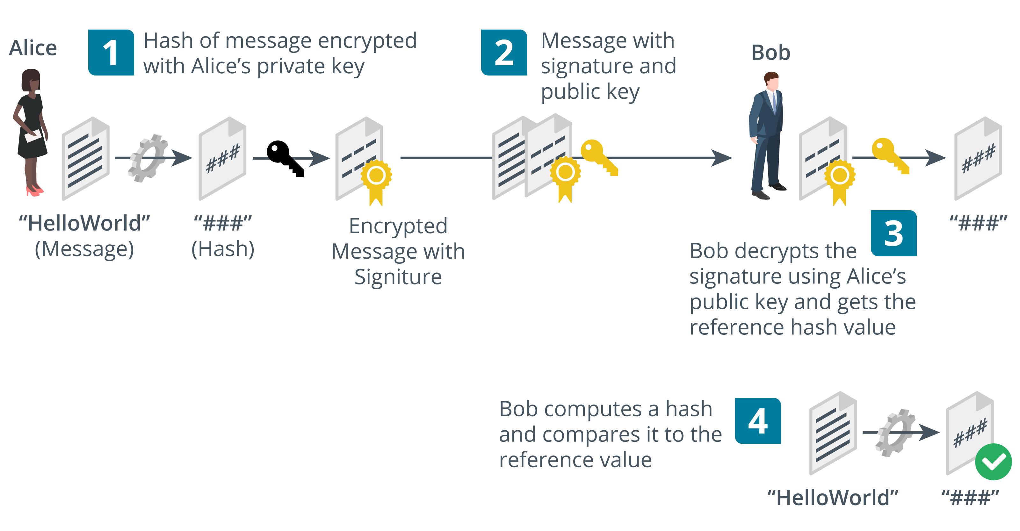
Digital Signatures A digital signature—a type of electronic signature—is a mathematical algorithm routinely used to validate the authenticity and integrity of a message
Using public key (Asymmetric encryption) cryptography with hashing
Digital signatures provide integrity, authentication, non-repudiation
RSA-based digital signatures
Digital Signature Algorithm (DSA) with ECC cipher
Images © 123rf.com.
Notes:
Digital signatures combine public key cryptography with hashing algorithms to provide authentication, integrity, and non-repudiation.

Slide 13
Digital Certificates is a file that verifies the identity of a device or user and enables encrypted connections.
Wrapper for a public key to associate it with a digital identity
Identity assertion is validated by a certificate authority (CA) by signing the certificate
Both parties must trust the CA
Referred to as public key infrastructure (PKI)
M6S1 Introduction to Cybersecurity Defense
Notes:
We will explore certificates and PKI in more detail in the next lesson.

Slide 14
Cryptographic Modes of Operation
M6S1 Introduction to Cybersecurity Defense

Slide 15
Summarize Cryptographic Use Cases and Weaknesses
Topic 5C
M6S1 Introduction to Cybersecurity Defense
Notes:
Having established the types of cryptographic function and the use of hybrid encryption, this topic covers use cases, limitations, and weaknesses. We also look at the cryptographic attacks content examples from objective 1.2.

Slide 16
Syllabus Objectives Covered
1.2 Given a scenario, analyze potential indicators to determine the type of attack
2.8 Summarize the basics of cryptographic concepts
M6S1 Introduction to Cybersecurity Defense

Slide 17
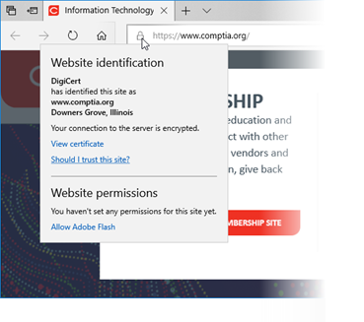
Cryptography for Authentication and Non-repudiation
Authentication and access control
Assuming the private key is secure, an encrypted token could only have been created by the key holder
Non-repudiation
Sender cannot deny (repudiate) the message as only she/he could have created it
Screenshot used with permission from Microsoft.
M6S1 Introduction to Cybersecurity Defense
Notes:
Cryptographic primitives are well-established, low-level cryptographic algorithms that are frequently used to build cryptographic protocols for computer security systems.
cryptosystem” is shorthand for “cryptographic system” and refers to a computer system that employs cryptography, a method of protecting information and communications through the use of codes so that only those for whom the information is intended can read and process it.

Slide 18
Cryptography Supporting Confidentiality
Hybrid encryption
Public key cryptography(asymmetric) is only efficient with small amounts of data
Symmetric encryption makes key distribution difficult
Symmetric key is used for bulk encryption and protected by public key cryptography (asymmetric)
File encryption
a way of encoding files, including the sensitive data they contain, in order to send them securely.
Transport encryption
Session key exchange/agreement
M6S1 Introduction to Cybersecurity Defense

Slide 19
Cryptography Supporting Integrity and Resiliency
Integrity
Using hash functions and message authentication codes to validate messages
Resiliency
Using cryptography to ensure authentication and integrity of control messages
Obfuscation
Make something hard to understand
Encryption can perform this function, but it is very hard to secure an embedded key
M6S1 Introduction to Cybersecurity Defense
Notes:
GCHQ’s Dr Ian Levy's article on designing the security system for smart meters in the UK (ncsc.gov.uk/information/the-smart-security-behind-the-gb-smart-metering-system) is a good example of some of the considerations that go into the design of a highly resilient system.

Slide 20
Cryptographic Performance Limitations
Limitations
Speed—Amount of data/number of operations per second
Time/latency—Delay in completing an operation
Size—Key size increases security but also CPU/memory requirements
Computational overhead—Complexity of cryptographic implementation or cipher
M6S1 Introduction to Cybersecurity Defense
Notes:
The syllabus places a lot of emphasis on limitations and use cases, so make sure students understand these factors.

Slide 21
Attacks on Cryptography Man-in-the-Middle and Downgrade Attacks
Man-in-the-Middle (MitM)
Interferes with the public key presented to the client
Downgrade attack
Forces server into using weak protocol versions and ciphers
M6S1 Introduction to Cybersecurity Defense

Slide 22
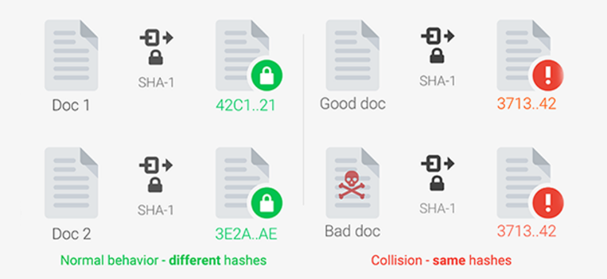
Collisions Attack
Exploit collisions to forge a signature
Math of birthday paradox shows that this might be easier than expected
Chosen prefix collision attacks
M6S1 Introduction to Cybersecurity Defense

Slide 23
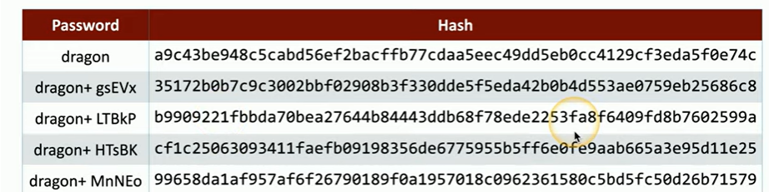
Solutions Key Stretching and Salting solutions
Key stretching
Use additional rounds to strengthen keys - hash1 +hash 2+hash3
Makes attacker do more work so slows down brute force
Bcrypt tool
Salting
Add a random value to each password when hashing it for storage
Prevents use of pre-computed hash tables
M6S1 Introduction to Cybersecurity Defense

Slide 24
Cryptographic Use Cases and Weaknesses
M6S1 Introduction to Cybersecurity Defense

Slide 25
Summarize Other Cryptographic Technologies
Topic 5D
M6S1 Introduction to Cybersecurity Defense
Notes:
This topic collects the remaining content examples from objective 2.8. While students need to know these for the exam, they are not critical to understanding authentication and authorization technologies. If students are feeling overloaded, you may want to skip this topic or leave it to later in the course.

Slide 26
Syllabus Objectives Covered
2.8 Summarize the basics of cryptographic concepts
M6S1 Introduction to Cybersecurity Defense

Slide 27
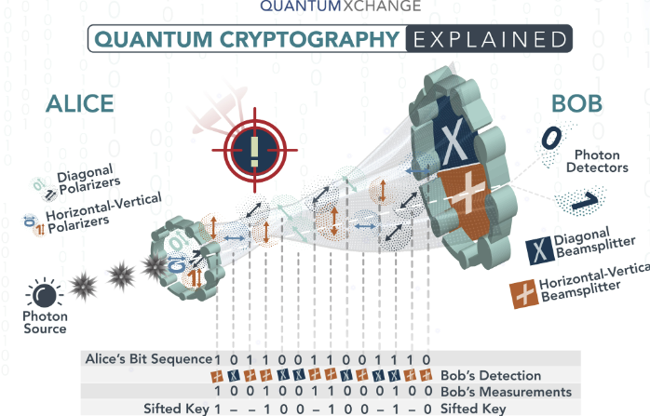
Quantum
Quantum computing – Based on Quantum Physics than classical physics(0,1) bits,
Quantum bits not 0 or 1, anything between the two
Quantum computers can keep track of a lot of state data at the same time
Post-quantum
Quantum-based cryptanalysis
Post-quantum cryptography (replacements for the current algorithms)
M6S1 Introduction to Cybersecurity Defense
Notes:
Quantum computing is an area of study focused on the development of computer based technologies centered around the principles of quantum theory.

Slide 28
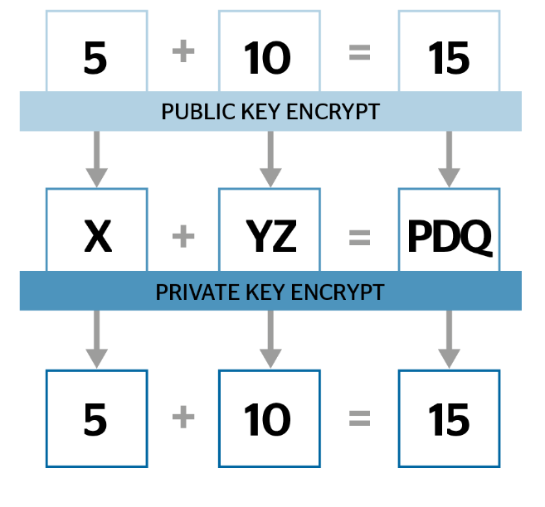
Homomorphic Encryption
Supports data analytics functions while preserving confidentiality and privacy
Perform calculation of encryption of data
M6S1 Introduction to Cybersecurity Defense
Notes:
We're keeping this here as part of objective 2.8, but note that it relates more to data privacy, which we'll get to later in the course.

Slide 29
Blockchain
Expanding list of transactional records (blocks)
Each block is linked by hashing
Public ledger
Ledger of transactions performed on a digital asset
Peer-to-peer so transactions are public
Transactions cannot be deleted or reversed
Widely used for cryptocurrencies
Potential uses for financial transactions, online voting systems, identity management systems, notarization, data storage, …
M6S1 Introduction to Cybersecurity Defense

Slide 30
Steganography
Concealing messages within a covertext
Often uses file data that can be manipulated without introducing obvious artifacts
Image
Audio
Video
Covert channels
M6S1 Introduction to Cybersecurity Defense
Notes:
There are various software applications for inserting and detecting steganographic messages. When hiding messages in files, a substitution technique such as least significant bit is preferable to simply inserting a message as it does not alter the file size.

Slide 31
Summary
Lesson 5
M6S1 Introduction to Cybersecurity Defense
Notes:
Check that students are confident about the content that has been covered. If there is time, revisit any content examples that they have questions about. If you have used all the available time for this lesson block, note the issues, and schedule time for a review later in the course.

